Slide 1
Credit Card Fraud Detection Using Machine Learning
Souvik Dey, RA1911029010017

Slide 2
INTRODUCTION
Credit card fraud detection is presently the most frequently occurring problem in the present world. We made an attempt for finding the frauds in the credit card business by using the algorithms which adopted machine learning techniques. We are using Decision Tree, Random Forest and Extreme Gradient boosting algorithms. The efficiency of the model can be decided by using some public data as sample. Then, an actual world credit card facts group from a financial institution is examined. Along with this, some clatter is supplemented to the data samples to auxiliary check the sturdiness of the systems. The significance of the methods used in the paper is the first method constructs a tree against the activities performed by the user and using this tree scams will be suspected. In the second method a user activity based forest will have constructed and using this forest an attempt will be made in identifying the suspect. The investigational outcomes absolutely show that the mainstream elective technique attains decent precision degrees in sensing scam circumstances in credit cards.

Slide 3
Problem Statement
Falsification of the credit card can be defined as the unapproved use of a customer’s card data to create purchases or to dismiss funds from the cardholder's record. The misconduct extortion starts from the credit card when somebody incorrectly acquires the number printed on card or the essential records for the card to be operated. The owner of the card, the agent by whom card is issued and even guarantor of a card might not be informed of the fraud until the record is used to create purchases. As shopping through internet-based applications and paying bills online has been come into practice, there is no longer requirement of a physical card to create purchases.
Fraud detection in online shopping systems is the hottest topic nowadays. Fraud investigators, banking systems, and electronic payment systems such as PayPal must have an efficient and complex fraud detection system to prevent fraud activities that change rapidly. According to a Cyber Source report from 2017, the present fraud loss by order channel, that is, the percentage of fraud loss in their web store was 74 percent and 49 percent in their mobile channels. Based on this information, the lesson is to determine anomalies across patterns of fraud behavior that have undergone change relative to the past
The rising of E-commerce business has resulted in a gentle growth within the usage of credit cards for online transactions and purchases. With the rise in the usage of credit cards, the number of fraud cases has also been doubled. Credit card frauds are those which are done with an intention to gain money in a deceptive manner without the knowledge of the cardholder.

Slide 4
EXISTING SYSTEM
Much research has been done on studying credit card fraud detection. In past people manually detect fraud transactions. But, the entire problem of credit card fraud detection suffers from a problem of Imbalanced data (a very highly imbalanced data). This problem requires us to heavily process the data before training any machine learning model like SVM etc.
DISADVANTAGES:
• Low accuracy.
• Time consuming.
• High complexities.

Slide 5
PROPOSED SYSTEM
We propose this system to investigate a problem of whether it is valuable or not to use machine learning techniques of RandomForestClassifier, ExtraTreesClassifier, DecisionTreeClassifier, Logistic Regression, XGBClassifier, and AdaBoostClassifier. to detect whether the credit card is fraud or not fraud.
Advantages:
Has highest accuracy
Reduces time complexity.
Better information on Relief features.

Slide 6
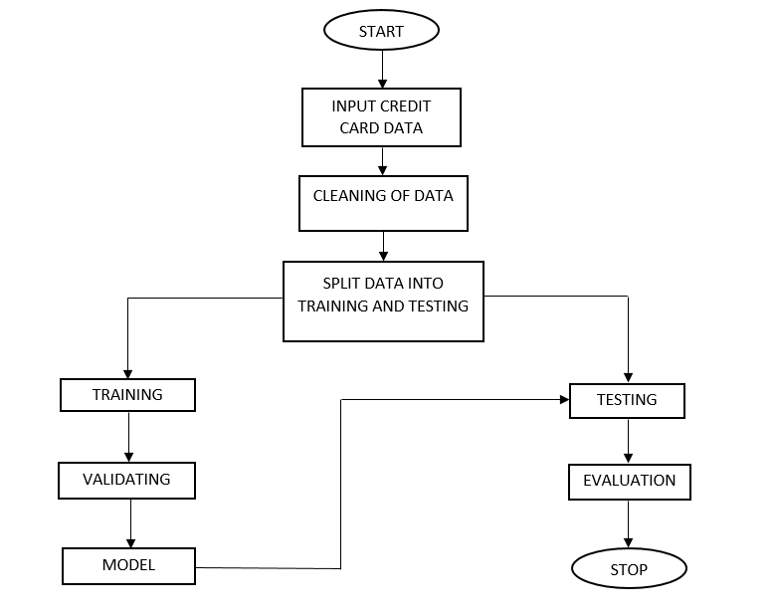
BLOCK DIAGRAM

Slide 7
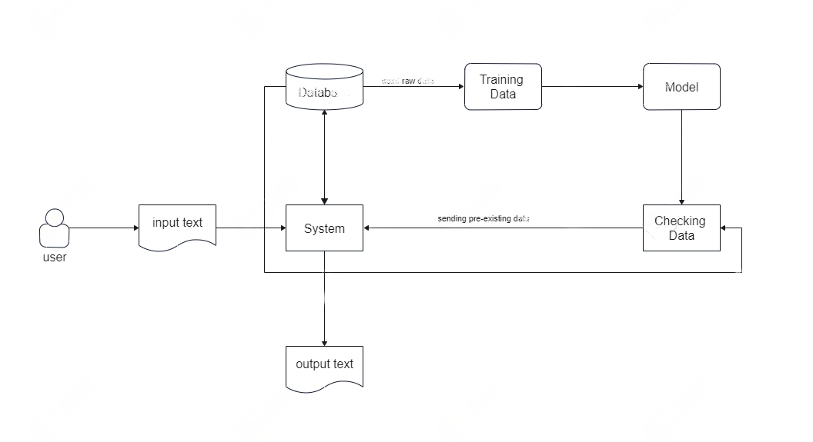
Architecture:

Slide 8
ALGORITHMS
Random Forest :
Random forest is an extension over bagging. It takes one extra step where in addition to taking the random subset of data, it also takes the random selection of features rather than using all features to grow trees. When you have many random trees. It’s called Random Forest Suppose there are N observations and M features in training data set. First, a sample from training data set is taken randomly with replacement. A subset of M features are selected randomly and whichever feature gives the best split is used to split the node iteratively The tree is grown to the largest Above steps are repeated and prediction is given based on the aggregation of predictions from n number of trees Handles higher dimensionality data very well. Handles missing values and maintains accuracy for missing data.
Bagging :
Bagging is an ensemble algorithm that fits multiple models on different subsets of a training dataset, then combines the predictions from all models. Random forest is an extension of bagging that also randomly selects subsets of features used in each data sample. Both bagging and random forests have proven effective on a wide range of different predictive modelling problems. Although effective, they are not suited to classification problems with a skewed class distribution. Nevertheless, many modifications to the algorithms have been proposed that adapt their behaviour and make them better suited to a severe class imbalance

Slide 9
Decision Tree
Decision Tree is a Supervised Machine Learning approach to solve classification and regression problems by continuously splitting data based on a certain parameter. The decisions are in the leaves and the data is split in the nodes. In Classification Tree the decision variable is categorical (outcome in the form of Yes/No) and in Regression tree the decision variable is continuous. Decision Tree has the following advantages: it is suitable for regression as well as classification problem, ease in interpretation, ease of handling categorical and quantitative values, capable of filling missing values in attributes with the most probable value, high performance due to efficiency of tree traversal algorithm.
Decision Tree might encounter the problem of over-fitting for which Random Forest is the solution which is based on ensemble modelling approach. Disadvantages of decision tree is that it can be unstable, it may be difficult to control size of tree, it may be prone to sampling error and it gives a locally optimal solution- not globally optimal solution. Decision Trees can be used in applications like predicting future use of library books and tumour prognosis problems.

Slide 10
AdaBoost
AdaBoost algorithm, short for Adaptive Boosting, is a Boosting technique used as an Ensemble Method in Machine Learning. It is called Adaptive Boosting as the weights are re-assigned to each instance, with higher weights assigned to incorrectly classified instances. Boosting is used to reduce bias as well as variance for supervised learning. It works on the principle of learners growing sequentially. Except for the first, each subsequent learner is grown from previously grown learners. In simple words, weak learners are converted into strong ones. The AdaBoost algorithm works on the same principle as boosting with a slight difference. Let’s discuss this difference in detail.First, let us discuss how boosting works. It makes ‘n’ number of decision trees during the data training period. As the first decision tree/model is made, the incorrectly classified record in the first model is given priority. Only these records are sent as input for the second model. The process goes on until we specify a number of base learners we want to create. Remember, repetition of records is allowed with all boosting techniques.This figure shows how the first model is made and errors from the first model are noted by the algorithm. The record which is incorrectly classified is used as input for the next model. This process is repeated until the specified condition is met. As you can see in the figure, there are ‘n’ number of models made by taking the errors from the previous model. This is how boosting works. The models 1,2, 3,…, N are individual models that can be known as decision trees. All types of boosting models work on the same principle.

Slide 11
LOGISTIC REGRESSION
Logistic Regression was used in the biological sciences in early twentieth century. It was then used in many social science applications. Logistic Regression is used when the dependent variable (target) is categorical.For example,
To predict whether an email is spam (1) or (0)
Whether the tumor is malignant (1) or not (0)
Consider a scenario where we need to classify whether an email is spam or not. If we use linear regression for this problem, there is a need for setting up a threshold based on which classification can be done. Say if the actual class is malignant, predicted continuous value 0.4 and the threshold value is 0.5, the data point will be classified as not malignant which can lead to serious consequence in real time.From this example, it can be inferred that linear regression is not suitable for classification problem. Linear regression is unbounded, and this brings logistic regression into picture. Their value strictly ranges from 0 to 1.

Slide 12
Extra Trees:
Extra Trees is an ensemble machine learning algorithm that combines the predictions from many decision trees.
It is related to the widely used random forest algorithm. It can often achieve as-good or better performance than the random forest algorithm, although it uses a simpler algorithm to construct the decision trees used as members of the ensemble.
It is also easy to use given that it has few key hyperparameters and sensible heuristics for configuring these hyperparameters.
In this tutorial, you will discover how to develop Extra Trees ensembles for classification and regression.

Slide 13
XGBoost
XGBoost stands for “Extreme Gradient Boosting”. XGBoost is an optimized distributed gradient boosting library designed to be highly efficient, flexible and portable. It implements Machine Learning algorithms under the Gradient Boosting framework. It provides a parallel tree boosting to solve many data science problems in a fast and accurate way.
Boosting
Boosting is an ensemble learning technique to build a strong classifier from several weak classifiers in series. Boosting algorithms play a crucial role in dealing with bias-variant trade off. Unlike bagging algorithms, which only controls for high variance in a model, boosting controls both the aspects (bias & variance) and is considered to be more effective.
Below are the few types of boosting algorithms:
AdaBoost (Adaptive Boosting)
Gradiant Boosting
XGBoost
CatBoost
Light GBM

Slide 14
SUPPORT VECTOR MACHINES:
The objective of the support vector machine algorithm is to find a hyper plane in an N-dimensional space (N — the number of features) that distinctly classifies the data points.
Possible hyper planes :
To separate the two classes of data points, there are many possible Hyper planes that could be chosen. Our objective is to find a plane that has the maximum margin, i.e. the maximum distance between data points of both classes. Maximizing the margin distance provides some reinforcement so that future data points can be classified with more confidence.
Hyper planes in 2D and 3D feature space
Hyper planes are decision boundaries that help classify the data points. Data points falling on either side of the hyper plane can be attributed to different classes. Also, the dimension of the hyper plane depends upon the number of features. If the number of input features is 2, then the hyper plane is just a line. If the number of input features is 3, then the hyper plane becomes a two-dimensional plane. It becomes difficult to imagine when the number of features exceeds 3.

Slide 15
Thank You

